Slide 1
Firewall Technologies

Slide 2
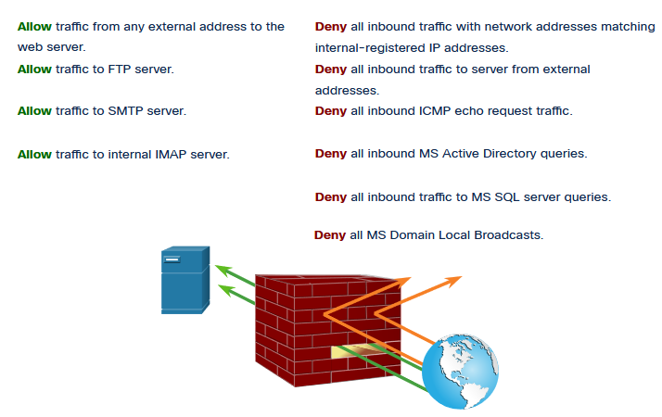
Secure Networks with Firewalls
Firewalls
All firewalls share some common properties:
Firewalls are resistant to network attacks.
Firewalls are the only transit point between internal corporate networks and external networks because all traffic flows through the firewall.
Firewalls enforce the access control policy.
Different types of firewalls have different benefits and limitations.

Slide 3
Secure Networks with Firewalls
Types of Firewalls
It is important to understand the different types of firewalls and their specific capabilities so that the right firewall is used for each situation.
Packet Filtering (Stateless) firewalls - These are usually part of a router firewall, which permits or denies traffic based on Layer 3 and Layer 4 information. They are stateless firewalls that use a simple policy table look-up that filters traffic based on specific criteria.
Stateful firewalls – These are the most versatile and the most common firewall technologies in use. Stateful firewalls provide stateful packet filtering by using connection information maintained in a state table. Stateful filtering is a firewall architecture at the network layer.
Application Gateway (Proxy) firewalls – These filter information at Layers 3, 4, 5, and 7. Most of the firewall control and filtering is done in software. When a client needs to access a remote server, it connects to a proxy server.
Next Generation firewalls – These go beyond stateful firewalls by providing integrated intrusion prevention, application awareness and control, upgrade paths to include future information feeds, and techniques to address evolving security threats.

Slide 4
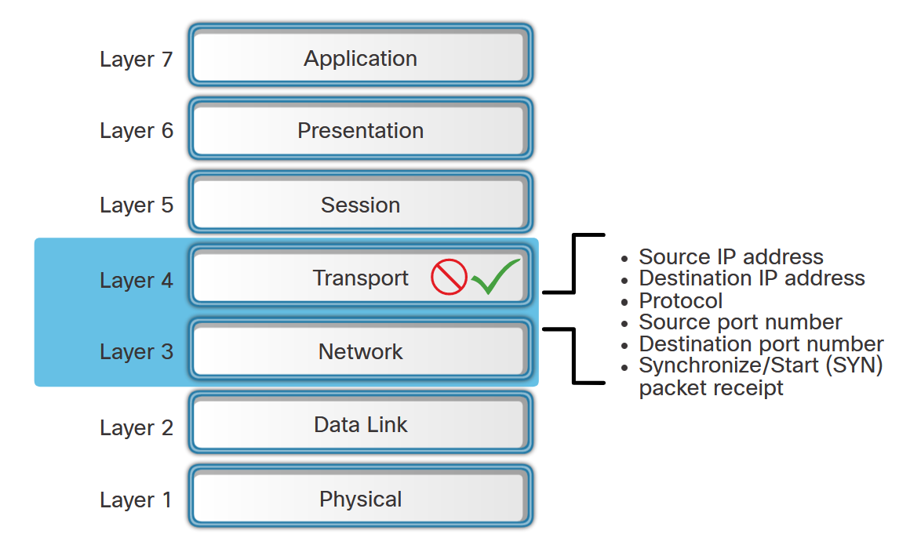
Secure Networks with Firewalls
Packet Filtering Firewall Benefits and Limitations
Benefits of Packet Filtering Firewalls:
They implement simple permit or deny rule sets.
They have a low impact on network performance.
They are easy to implement and are supported by most routers.
They provide an initial degree of security at the network layer.
They perform many of the tasks of a high-end firewall at a much lower cost.
Limitations of Packet Filtering Firewalls:
They are susceptible to IP spoofing.
They do not reliably filter fragmented packets.
They use complex ACLs, which can be difficult to implement and maintain.
They cannot dynamically filter certain services.
They are stateless.

Slide 5
Secure Networks with Firewalls
Stateful Firewall Benefits and Limitations
The table lists benefits and limitations of stateful firewalls.
Benefits | Limitations
Primary means of defense | No Application Layer inspection
Strong packet filtering | Limited tracking of stateless protocols
Improved performance over packet filters | Difficult to defend against dynamic port negotiation
Defends against spoofing and DoS attacks | No authentication support
Richer data log

Slide 6
Firewalls in Network Design

Slide 7
Firewalls in Network Design
Common Security Architectures
Firewall design is primarily about device interfaces permitting or denying traffic based on the source, the destination, and the type of traffic. Here are three common firewall designs:
Private and Public
Demilitarized Zone (DMZ)
Zone-Based Policy

Slide 8
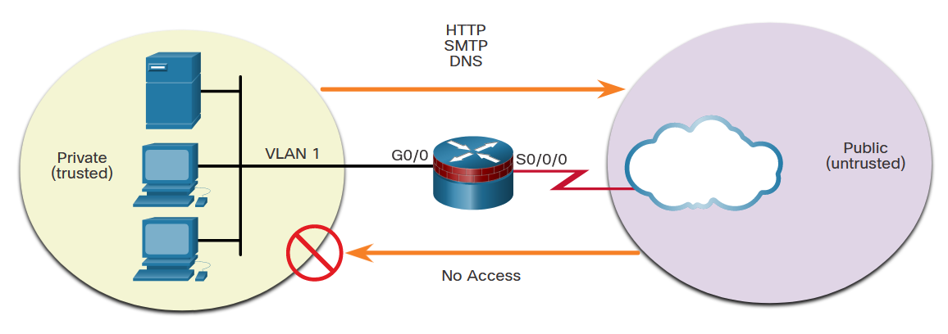
Firewalls in Network Design
Common Security Architectures (Cont.)
Private and Public - The public network (or outside network) is untrusted, and the private network (or inside network) is trusted.

Slide 9
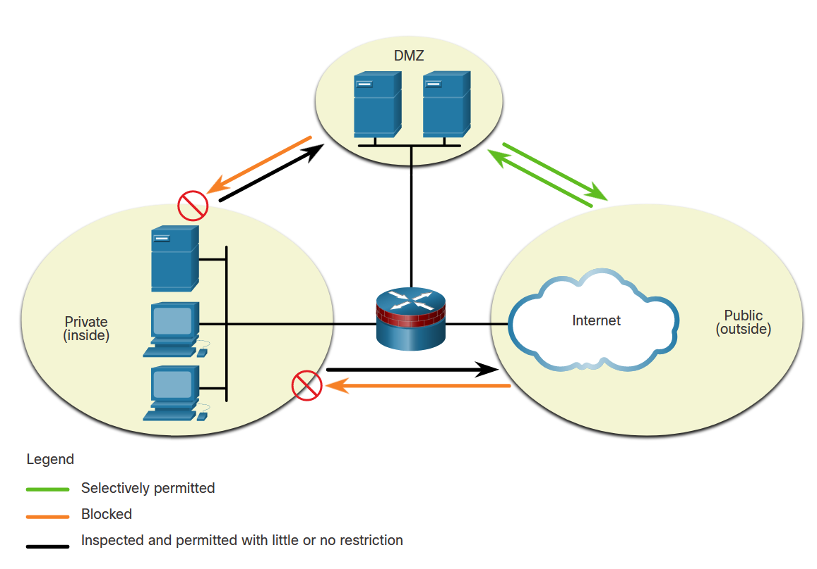
Firewalls in Network Design
Common Security Architectures (Cont.)
Demilitarized Zone (DMZ) - This is a firewall design where there is typically one inside interface connected to the private network, one outside interface connected to the public network, and one DMZ interface.

Slide 10
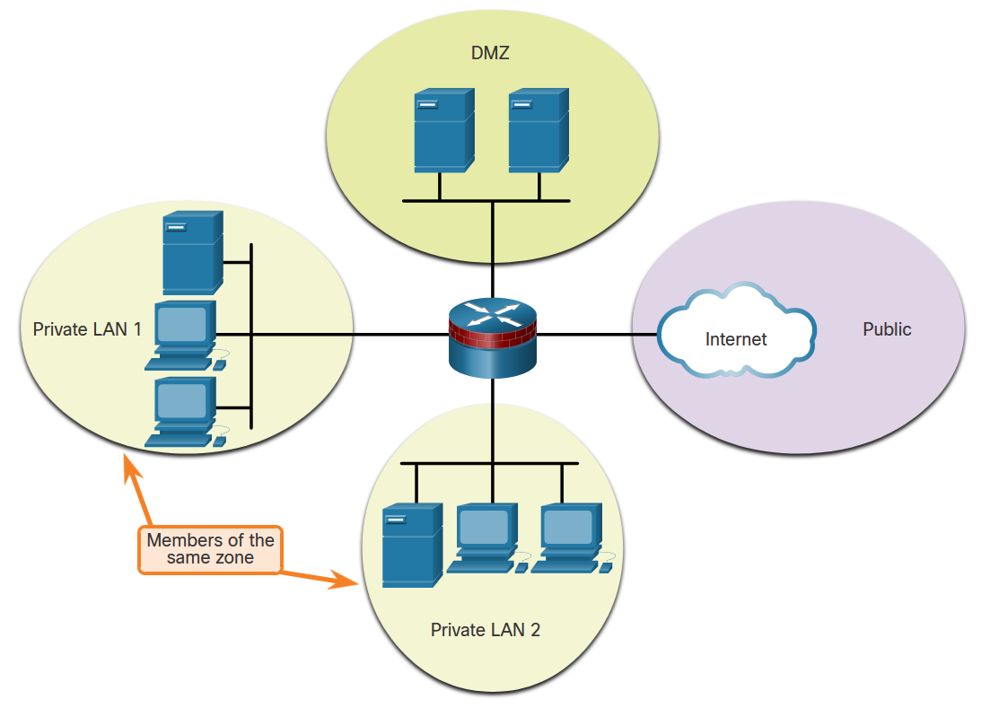
Firewalls in Network Design
Common Security Architectures
Zone-Based Policy - Zone-based policy firewalls (ZPFs) use the concept of zones to provide additional flexibility. A zone is a group of one or more interfaces that have similar functions or features. Zones help you specify where a Cisco IOS firewall rule or policy should be applied.

Slide 11
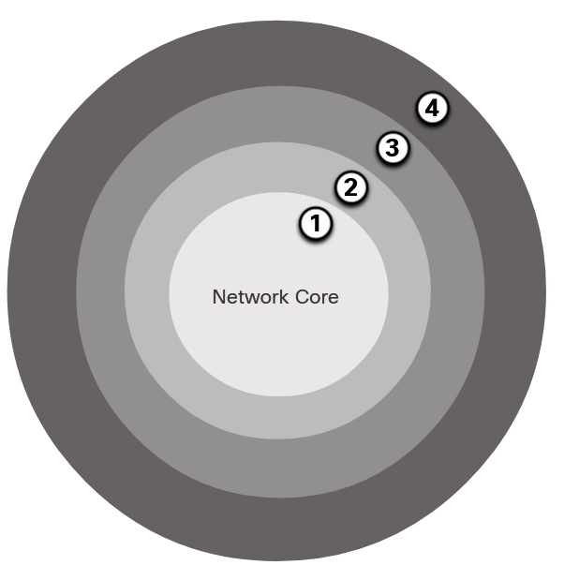
Firewalls in Network Design
Layered Defense
A layered defense uses different types of firewalls that are combined in layers to add depth to the security of an organization. Policies can be enforced between the layers and inside the layers. The following example shows four layers of security.
Network Core security - Protects against malicious software and traffic anomalies, enforces network policies, and ensures survivability
Perimeter security - Secures boundaries between zones
Communications security - Provides information assurance
Endpoint security - Provides identity and device security policy compliance

Slide 12
Firewalls in Network Design
Layered Defense (Cont.)
This partial list of best practices can serve as a starting point for a firewall security policy.
Position firewalls at security boundaries. Firewalls are a critical part of network security, but it is unwise to rely exclusively on a firewall for security.
Deny all traffic by default.
Permit only services that are needed.
Ensure that physical access to the firewall is controlled.
Regularly monitor firewall logs.
Practice change management for firewall configuration changes.
Remember that firewalls primarily protect from technical attacks originating from the outside.

Slide 13
Zone-Based Policy Firewalls

Slide 14
ZPF Overview
Benefits of a ZPF
There are two configuration models for Cisco IOS Firewall:
Classic Firewall - The traditional configuration model in which firewall policy is applied on interfaces.
Zone-based Policy Firewall (ZPF) - The new configuration mode in which interfaces are assigned to security zones, and firewall policy is applied to traffic moving between the zones.
There are several benefits of a ZPF:
It is not dependent on ACLs.
The router security posture is to block unless explicitly allowed.
Virtual and physical interfaces can be grouped into zones.
Policies are applied to unidirectional traffic between zones.

Slide 15
ZPF Overview
ZPF Design
Designing ZPFs involves several steps:
Step 1. Determine the zones. A zone defines a boundary where traffic is subjected to policy restrictions as it crosses to another region of the network.
Step 2. Establish policies between zones. Define the sessions that clients in the source zones can request from servers in destination zones.
Step 3. Design the physical infrastructure. This includes dictating the number of devices between most-secure and least-secure zones and determining redundant devices.
Step 4. Identify subsets within zones and merge traffic requirements. Although an important consideration, implementing zone subsets is beyond the scope of this curriculum.

Slide 16
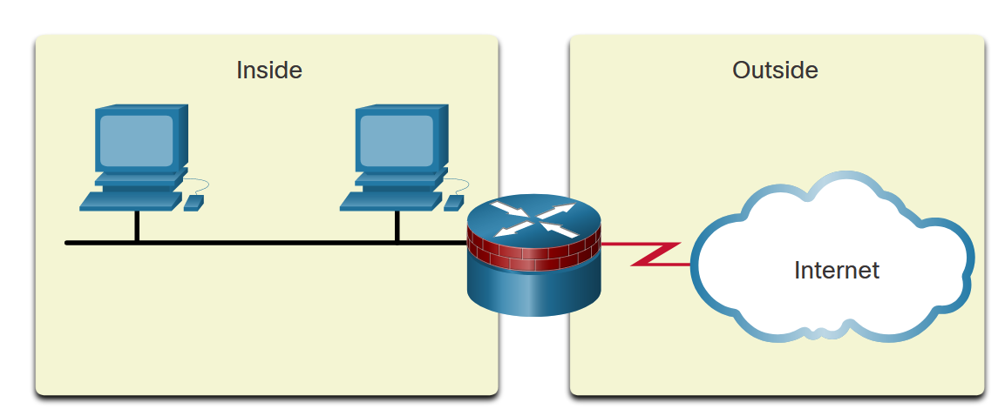
ZPF Overview
ZPF Design (Cont.)
LAN to Internet Example

Slide 17
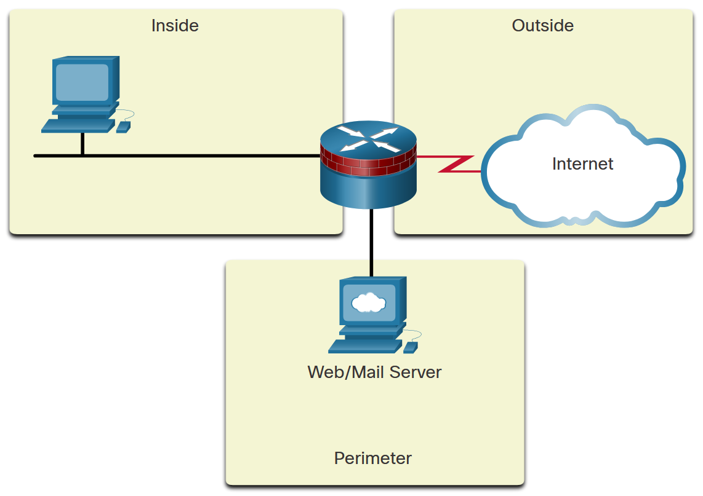
ZPF Overview
ZPF Design (Cont.)
Firewall with Public Servers Example 1

Slide 18
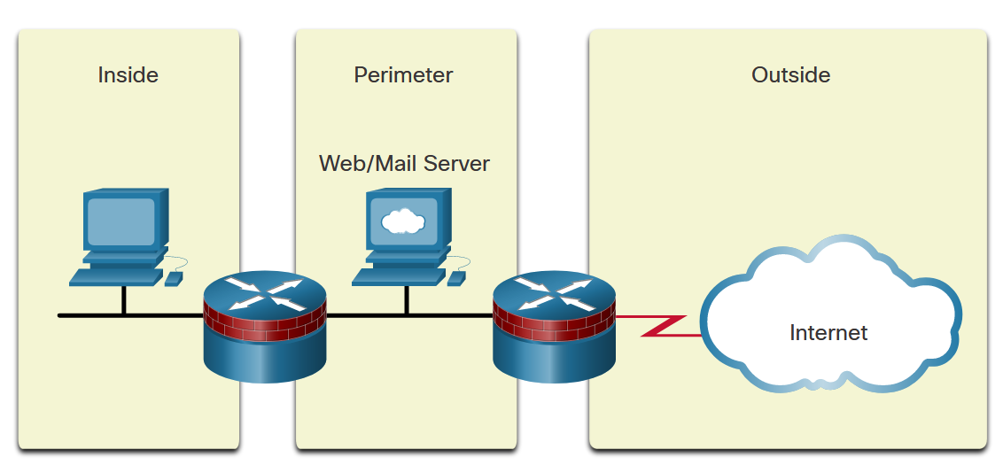
ZPF Overview
ZPF Design (Cont.)
Firewall with Public Servers Example 2

Slide 19
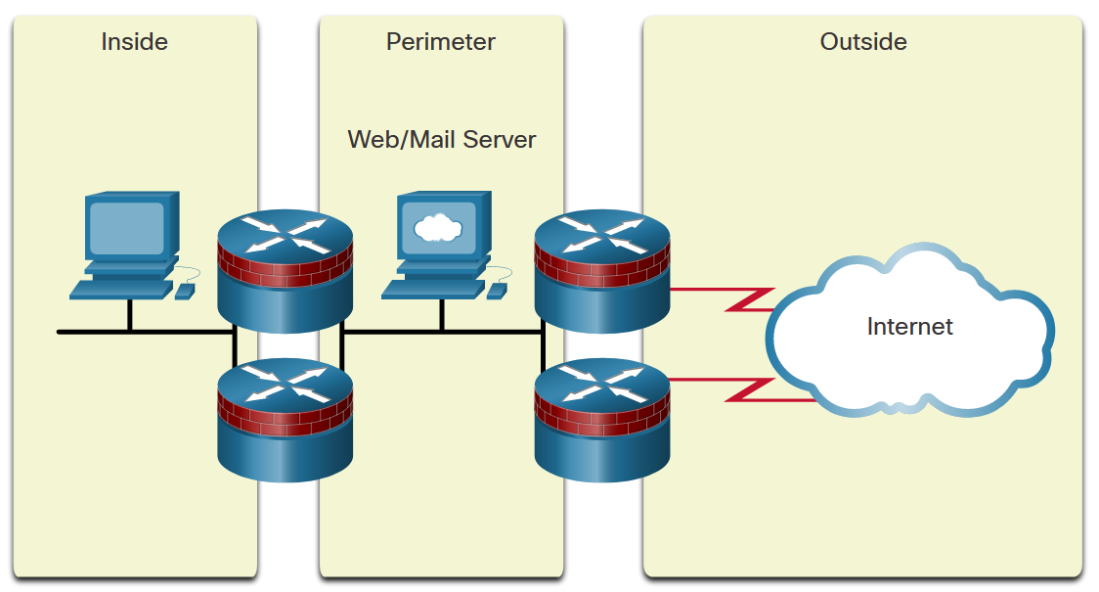
ZPF Overview
ZPF Design (Cont.)
Redundant Firewalls

Slide 20
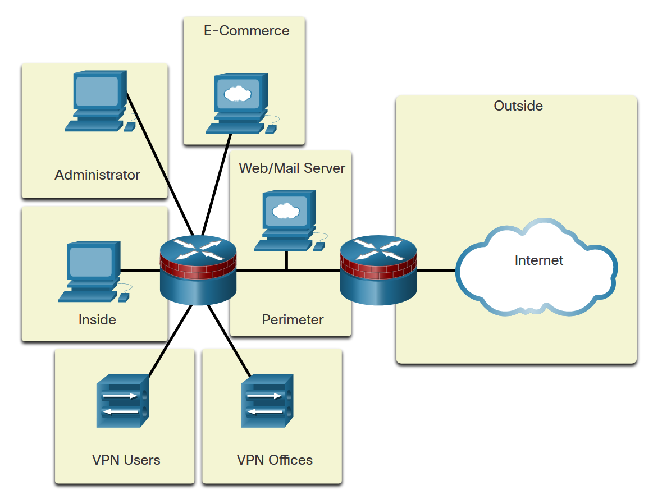
ZPF Overview
ZPF Design (Cont.)
Complex Firewall

Slide 21
ZPF Operation
ZPF Actions
Policies identify actions that the ZPF will perform on network traffic. Three possible actions can be configured to process traffic by protocol, source and destination zones (zone pairs), and other criteria.
Inspect - Performs stateful packet inspection.
Drop - Analogous to a deny statement in an ACL. A log option is available to log the rejected packets.
Pass - Analogous to a permit statement in an ACL. The pass action does not track the state of connections or sessions within the traffic.
Notes:
Inspect - The traffic is permitted and inspected statefully so that return traffic in the opposite direction is also permitted

Slide 22
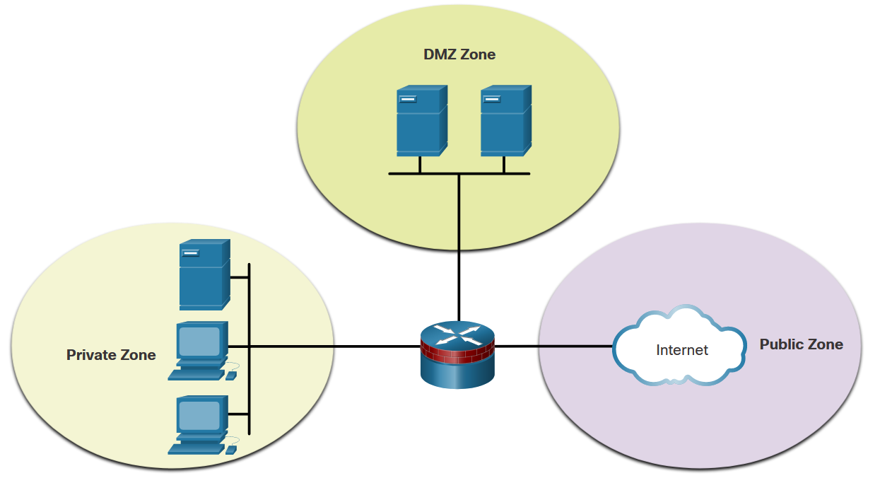
ZPF Operation
Rules for Transit Traffic
Traffic transiting through router interfaces is subject to several rules governing interface behavior. For the transit traffic example, refer to the topology shown in the figure.
Source Interface Member of Zone? | Destination Interface Member of Zone? | Zone-Pair Exists? | Policy Exists? | Result
NO | NO | N/A | N/A | PASS
YES | NO | N/A | N/A | DROP
NO | YES | N/A | N/A | DROP
YES (private) | YES (private) | N/A | N/A | PASS
YES (private) | YES (public) | NO | N/A | DROP
YES (private) | YES (public) | YES | NO | PASS
YES (private) | YES (public) | YES | YES | INSPECT

Slide 23
ZPF Operation
Rules for Traffic to the Self Zone
The self zone is the router itself and includes all the IP addresses assigned to the router interfaces. This is traffic that originates at the router or is addressed to a router interface.
The rules depend on whether the router is the source or the destination of the traffic, as shown in the table.
Source Interface Member of Zone? | Destination Interface Member of Zone? | Zone-Pair Exists? | Policy Exists? | Result
YES (self zone) | YES | NO | N/A | PASS
YES (self zone) | YES | YES | NO | PASS
YES (self zone) | YES | YES | YES | INSPECT
YES | YES (self zone) | NO | N/A | PASS
YES | YES (self zone) | YES | NO | PASS
YES | YES (self zone) | YES | YES | INSPECT

Slide 24
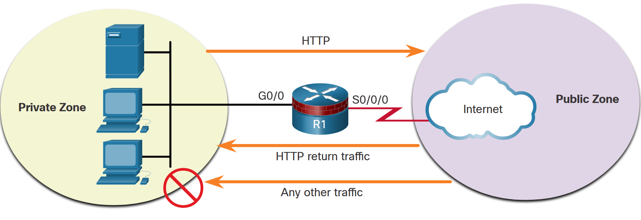
Configure a ZPF
Configure a ZPF
The topology and steps shown in the figure will be used throughout the remainder of this topic to demonstrate ZPF configuration.
Step 1: Create the zones.
Step 2: Identify traffic with a class-map.
Step 3: Define an action with a policy-map.
Step 4: Identify a zone pair and match it to a policy-map.
Step 5: Assign zones to the appropriate interfaces.

Slide 25
IPS Technologies

Slide 26
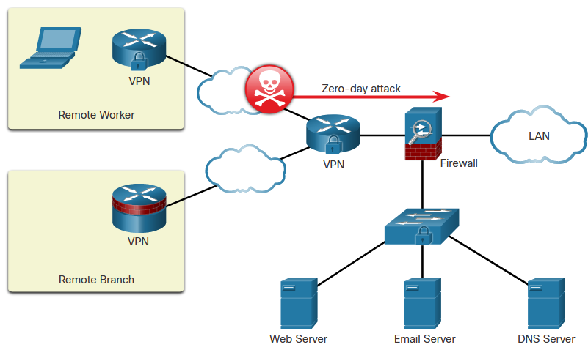
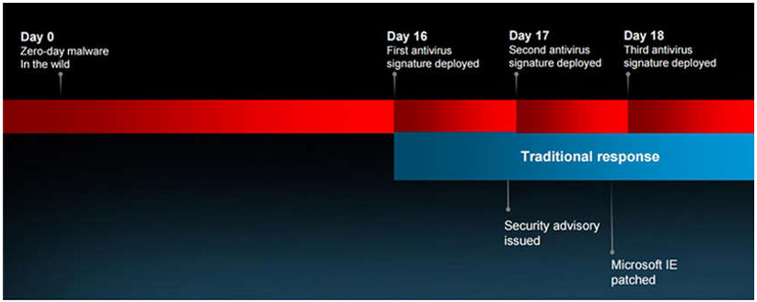
IDS and IPS Characteristics
Zero-Day Attacks
A zero-day attack is a cyberattack that tries to exploit software vulnerabilities that are unknown or undisclosed by the software vendor. The term zero-day describes the moment when a previously unknown threat is identified.
Microsoft Internet Explore Zero-Day Vulnerability

Slide 27
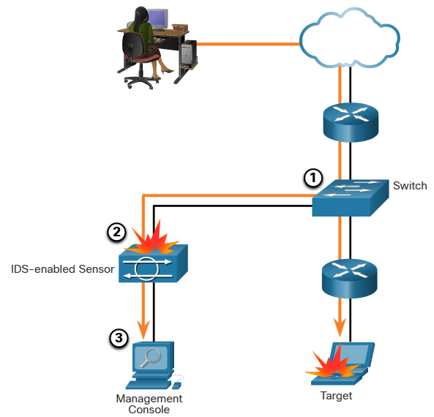
IDS and IPS Characteristics
Monitor for Attacks
Intrusion Detection Systems (IDS) were implemented to passively monitor the traffic on a network. The figure shows that an IDS-enabled device copies the traffic stream and analyzes the copied traffic rather than the actual forwarded packets. A better solution is to use a device that can immediately detect and stop an attack. An Intrusion Prevention System (IPS) performs this function.

Slide 28
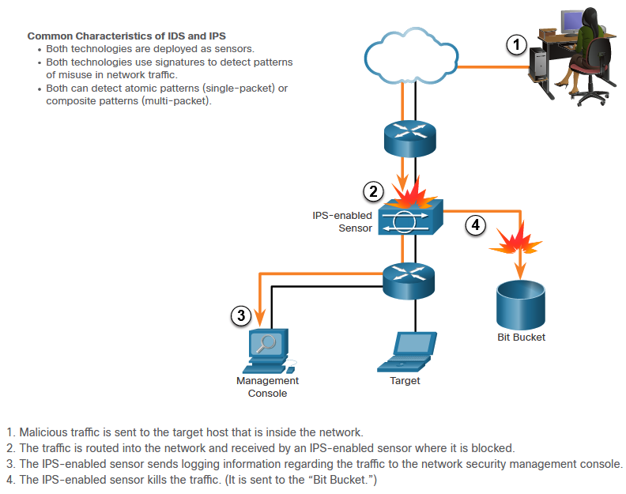
IDS and IPS Characteristics
Intrusion Prevention and Detection Devices

Slide 29
IDS and IPS Characteristics
Advantages and Disadvantages of IDS and IPS
Solution | Advantages | Disadvantages
IDS | No Impact on network (latency, jitter) No Network impact if there is a sensor failure No network impact if there is sensor overload | Response action cannot stop trigger packets Correct tuning required for response actions More vulnerable to network security evasion techniques
IPS | Stops trigger packets Can use stream normalization techniques | Sensor issues might affect network traffic Sensor overloading impacts the network Some impact on network (latency, jitter)

Slide 30
IPS Implementations

Slide 31
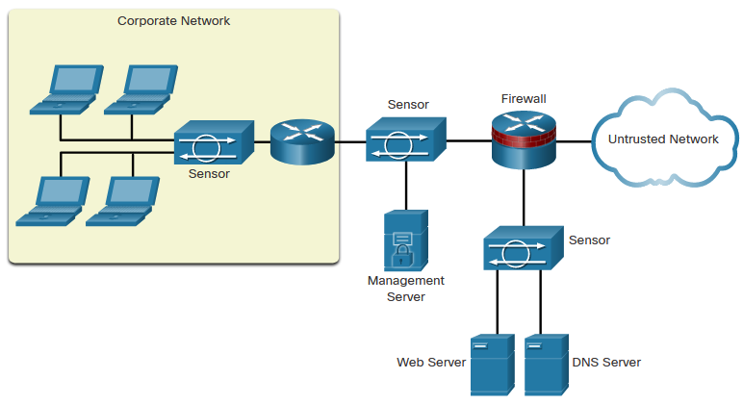
IPS Implementations
Types of IPS
There are two primary kinds of IPS available: host-based IPS (HIPS) and network-based IPS.
HIPS can be thought of as a combination of antivirus software, antimalware software, and a firewall. An example of a HIPS is Windows Defender. It provides a range of protection measures for Windows hosts.
A network-based IPS can be implemented using a dedicated or non-dedicated IPS device such as a router. Network-based IPS implementations are a critical component of intrusion prevention. Host-based IDS/IPS solutions must be integrated with a network-based IPS implementation to ensure a robust security architecture.
Sample IPS Sensor Deployment

Slide 32
IPS Implementations
Network-Based IPS
Network-based IPS Sensors can be implemented in several ways:
On a Cisco Firepower appliance
On an ASA firewall device
On an ISR router
As an NGIPSv for VMware
The hardware of all network-based sensors includes three components:
NIC - The network-based IPS must be able to connect to any network, such as Ethernet, Fast Ethernet, and Gigabit Ethernet.
Processor - Intrusion prevention requires CPU power to perform intrusion detection analysis and pattern matching.
Memory - Intrusion detection analysis is memory-intensive. Memory directly affects the ability of a network-based IPS to efficiently and accurately detect an attack.)

Slide 33

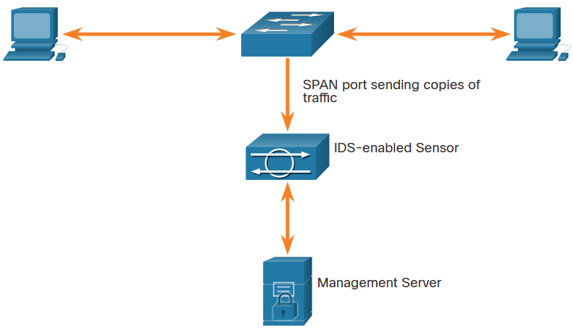
IPS Implementations
Modes of Deployment
Inline Mode
IDS and IPS sensors can operate in inline mode (also known as inline interface pair mode) or promiscuous mode (also known as passive mode).
Promiscuous
Mode

Slide 34
IPS Signatures
IPS Signature Attributes
The network must be able to identify incoming malicious traffic in order to stop it. Fortunately, malicious traffic displays distinct characteristics or “signatures”. Signatures uniquely identify specific viruses, worms, protocol anomalies, and malicious traffic.
PS sensors must be tuned to look for matching signatures or abnormal traffic patterns. As sensors scan network packets, they use signatures to detect known attacks and respond with predefined actions. An IDS or IPS sensor examines the data flow using many different signatures.
Signatures have three distinctive attributes:
Type - Atomic or Composite
Trigger - Also called the alarm
Action - What the IPS will do

Slide 35
IPS Signatures
Types of Signatures
Some threats can be identified in one packet while other threats may require many packets and their state information (i.e., IP addresses, port numbers, and more) to identify a threat.
There are two types of signatures:
Atomic Signature - This is the simplest type of signature because a single packet, activity, or event identifies an attack. The IPS does not need to maintain state information and traffic analysis can usually be performed very quickly and efficiently.
Composite Signature - Also called a stateful signature because the IPS requires several pieces of data to match an attack signature. The IPS must also maintain state information which is referred to as the event horizon. The length of an event horizon varies from one signature to the next.
The heart of any IPS signature is the signature alarm, which is often referred to as the signature trigger.
Notes:
An atomic alert signature is a single rule that triggers an alert when a specific condition is met. For example, an atomic signature may trigger an alert when it detects a specific string in network traffic.
On the other hand, a composite alert signature is a combination of multiple atomic signatures. Composite signatures may require the detection of multiple conditions or patterns before triggering an alert. For example, a composite signature may require the detection of specific network traffic patterns, combined with the presence of a specific file or process on a system.

Slide 36
IPS Signatures
IPS Signature Alarms
Every IPS incorporates signatures that use one or more of these basic triggering mechanisms to trigger signature actions. There are four general IPS signature trigger categories as listed in the table.
Detection Type | Advantages
Pattern-Based Detection | Also known as signature-based detection. Simplest triggering mechanism as it searches for a specific and pre-defined atomic or composite pattern. A IPS sensor compares the network traffic to a database of known attacks, and triggers an alarm or prevents communication if a match is found.
Anomaly-Based Detection | Also known as profile-based detection. Involves first defining a profile of what is considered normal network or host activity. This normal profile is usually defined by monitoring traffic and establishing a baseline. Once defined, any activity beyond a specified threshold in the normal profile will generate a signature trigger and action.
Policy-Based Detection | Also known as behavior-based detection. Although similar to pattern-based detection, an administrator manually defines behaviors that are suspicious based on historical analysis. The use of behaviors enables a single signature to cover an entire class of activities without having to specify each individual situation.
Honey Pot-Based Detection | Honey pot-based detection uses a server as a decoy server to attract attacks. The purpose of a decoy server is to lure attacks away from production devices. Allows administrators time to analyze incoming attacks and malicious traffic patterns to tune their sensor signatures.

Slide 37
IPS Signatures
IPS Signature Actions
Alert Category | Specific Action | Description
Generate an alert | Produce alert | The IPS sends events as alerts.
Generate an alert | Produce verbose alert | The IPS sends a detailed event alert.
Log the activity | Log attacker packets | Logs packets from the attacker IP address and sends an alert.
Log the activity | Log pair packets | Logs packets from the victim and attacker IP addresses and sends an alert.
Log the activity | Log victim packets | Logs packets from the victim IP address and sends an alert.
Deny the activity | Deny attacker inline | Terminates the current packet and future packets from this attacker address for a specified period of time.
Deny the activity | Deny connection inline | Logs packets from the victim IP address and sends an alert.
Deny the activity | Deny packet inline | Terminates the current packet and future packets from this attacker address for a specified period of time.

Slide 38
IPS Signatures
IPS Signature Actions (Cont.)
Alert Category | Specific Action | Description
Reset the TCP connection | Reset TCP connection | Sends TCP resets to hijack and terminate the TCP flow.
Block future activity | Request block connection | Sends a request to a blocking device to block this connection.
Block future activity | Request block host | Sends a request to a blocking device to block this attacker host.
Block future activity | Request SNMP trap | Sends a request to the notification application component of the sensor to perform SNMP notification.

Slide 39
IPS Signatures
Evaluating Alerts
The table summarizes the following four types of alarms.
Alarm Type | Network Activity | IPS Activity | Outcome
True positive | Attack traffic | Alarm generated | Ideal setting
True negative | Normal user traffic | No alarm generated | Ideal setting
False positive | Normal user traffic | Alarm generated | Tune alarm
False negative | Attack traffic | No alarm generated | Tune alarm

Slide 40
IPS Signatures
Evaluating Alerts (Cont.)
Alerts can be classified as follows:
True positive - (Desirable) This is used when the IPS generates an alarm because it detected know attack traffic. The alert has been verified to be an actual security incident and also indicates that the IPS rule worked correctly.
True negative - (Desirable) This is used when normal network traffic does not generate an alarm. No alerts are issued because the traffic that is passing through the system is clear of threats.
False positive - (Undesirable) This is used when an IPS generates an alarm after processing normal user traffic that should not have triggered an alarm. The IPS must be tuned to change these alarm types to true negatives. The alert does not indicate an actual security incident. Benign activity that results in a false positive is sometimes referred to as a benign trigger. False positives are costly because they must be investigated.
False negative - (Dangerous) This is used when an IPS fails to generate an alarm and known attacks are not being detected. This means that exploits are not being detected by the security systems that are in place. These incidents could go undetected for a long time, and ongoing data loss and damage could result. The goal is for these alarm types to generate true positive alarms.

